Slide 1
Image Inpainting using Deep Generative Modelling

Slide 2
Image inpainting is a fundamental computer vision task that aims to fill in missing or corrupted regions in an image while preserving its overall visual coherence and semantic Information.
Deep generative models, such as generative adversarial networks (GANs) and variational autoencoders (VAEs), are used for image inpainting tasks. These models learn the underlying distribution of the training data and can generate new samples that resemble the training data.

Slide 3
The image inpainting process typically involves the following steps:
Training
Mask creation
Encoding
Generation
Refinement

Slide 4
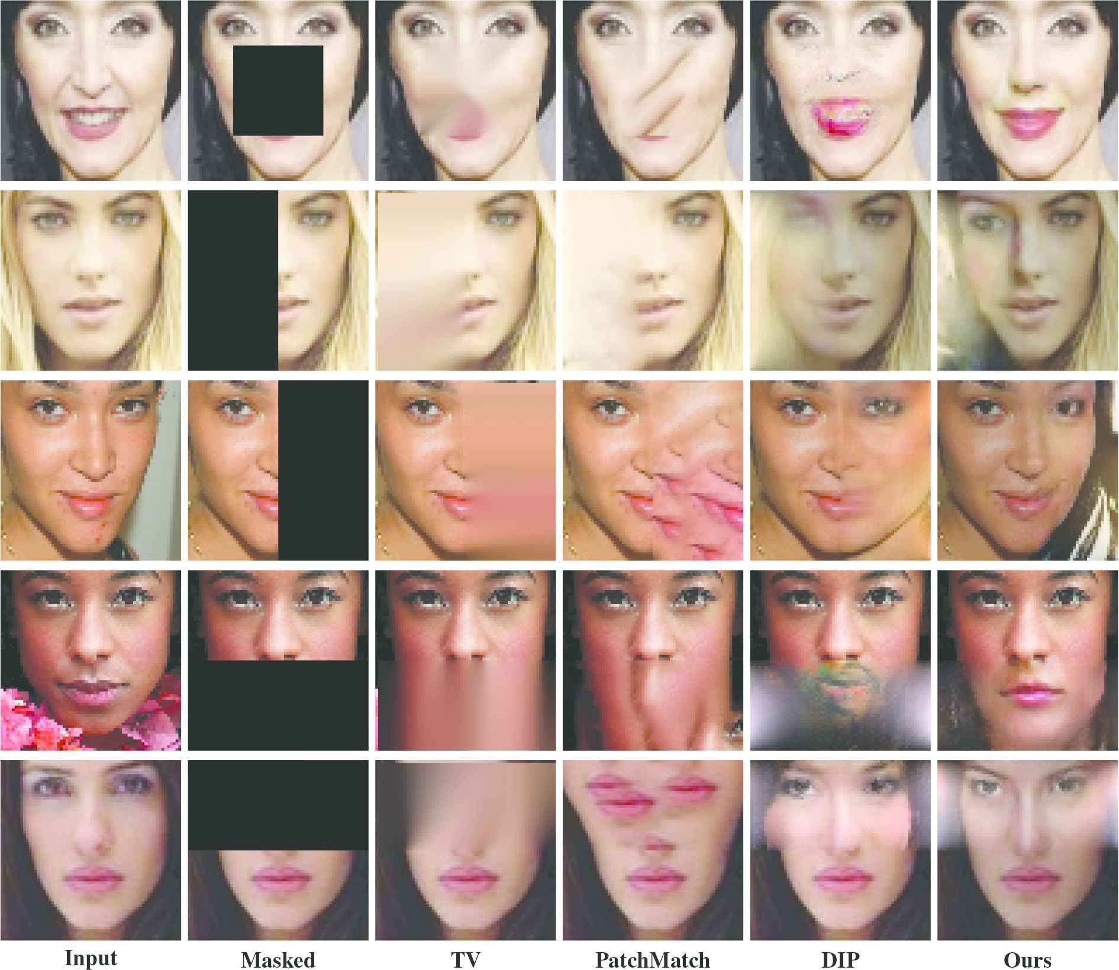
Training: A deep generative model is trained on a large dataset of complete images. The model learns to capture the patterns and structures present in the training images.

Slide 5
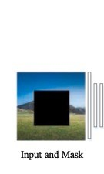
Mask Creation: A mask is created to indicate the regions of the image that need to be inpainted. The missing or damaged parts are usually represented by black pixels in the mask, while the rest of the image is white.

Slide 6
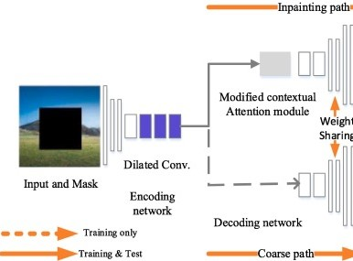
Encoding: The incomplete image, along with the corresponding mask, is fed into the trained generative model to encode the available information. The model maps the input image and mask to a latent space representation.

Slide 7
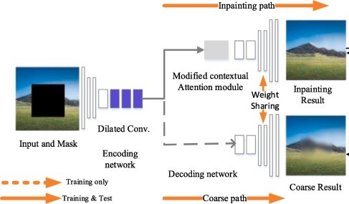
Generation: Using the encoded information from the previous step, the generative model generates new content to complete the missing regions. The model essentially learns to hallucinate plausible image content that matches the context and appearance of the surrounding pixels

Slide 8
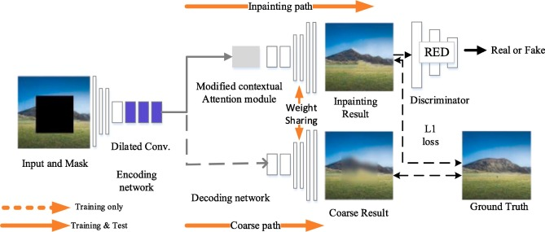
Refinement: The generated content is combined with the original image, taking into account the mask, to obtain the final inpainted image. Various post-processing techniques, such as blending or texture matching, can be applied to ensure a smooth transition between the inpainted regions and the original image.

Slide 9
THANKYOU
BALAGOUDA NIRWANI
2GI20EC032

